Slide 1
Infrastructure as Code (IaC)
Streamlining Infrastructure Management
Presenter: Nauria Gul – Lead DevOps Engineer

Slide 2
Agenda
Why IaC?
What is IaC?
Brief History
How does IaC works?
IaC Tools
Key Concepts of IaC
Benefits
IaC with Terraform
Terraform features
Terraform workflow
How does terraform works?
Different Types of Blocks in Terraform
Hands-on Lab

Slide 3
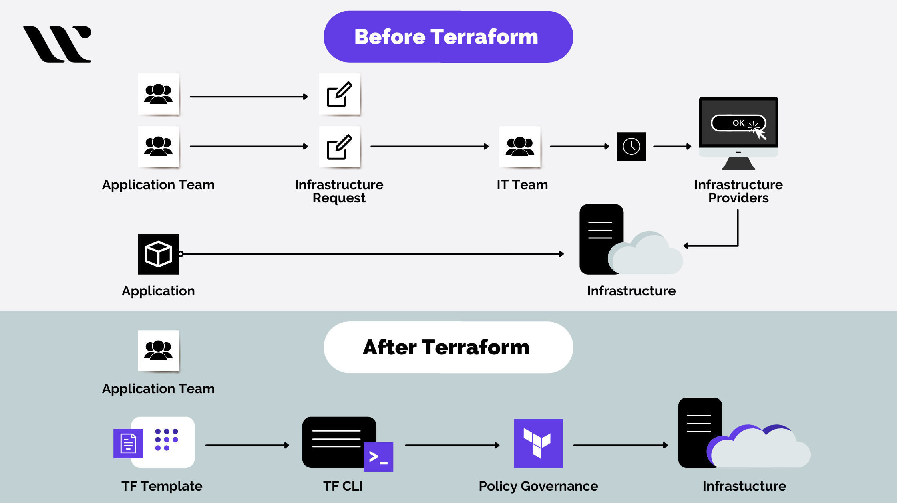
Why IaC?
Traditional infrastructure deployment
Manual and time-consuming process
Error-prone
Inconsistency
Configuration drift
Difficulty to keep multiple environments in lockstep
Scalability
Difficult to document
Notes:
Saad to share final Grafana dashboard

Slide 4

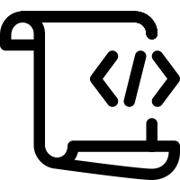









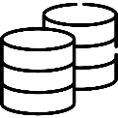
What is IaC?
Infrastructure as code is a modern approach to managing and provisioning infrastructure resources using code and automation. Instead of configuring and managing infrastructure manually, IaC allows you to define your infrastructure, including servers, networks, databases, and other resources, through code.
Repository
Templates
Scripts
Policies
Network
Security
App Infra
Storage
Notes:
Saad to share final Grafana dashboard

Slide 5
History
Early 2000s: Emergence of Automation Tools
The need for efficient and scalable infrastructure management led to the emergence of automation tools in the early 2000s.
Tools like Puppet and Chef gained popularity for automating configuration management tasks.
Mid-2000s: Rise of Virtualization
The mid-2000s saw a significant shift towards virtualization technologies.
Late 2000s: Configuration Management Tools
Configuration management tools like Puppet and Chef continued to evolve, providing a way to define and manage infrastructure as code.
2010: DevOps Movement
Virtualization allowed for the abstraction of physical hardware, enabling more flexible and scalable infrastructure.
2014: Launch of Terraform
2017: Cloud-Native Development
The DevOps movement gained momentum, emphasizing collaboration between development and operations teams.
HashiCorp launched Terraform in 2014, introducing a declarative approach to infrastructure provisioning and management.
Terraform allowed users to define infrastructure as code using HashiCorp Configuration Language (HCL).
With the rise of cloud-native development, IaC became even more crucial for managing dynamic and scalable cloud infrastructure.
IaC tools like Terraform, Ansible, and others became essential components of cloud orchestration and deployment.
Notes:
Saad to share final Grafana dashboard

Slide 6
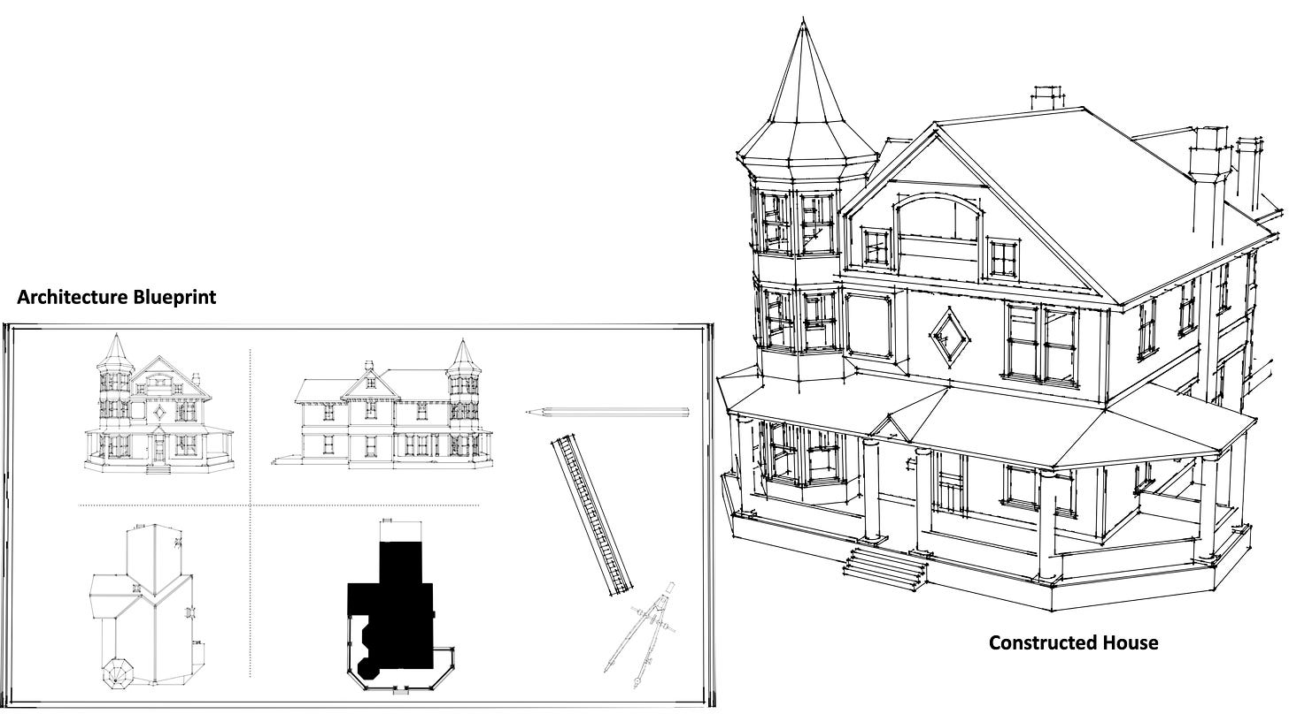
How does IaC Works?
It outlines the layout, dimensions, materials, and various components of the structure
Notes:
Saad to share final Grafana dashboard

Slide 7
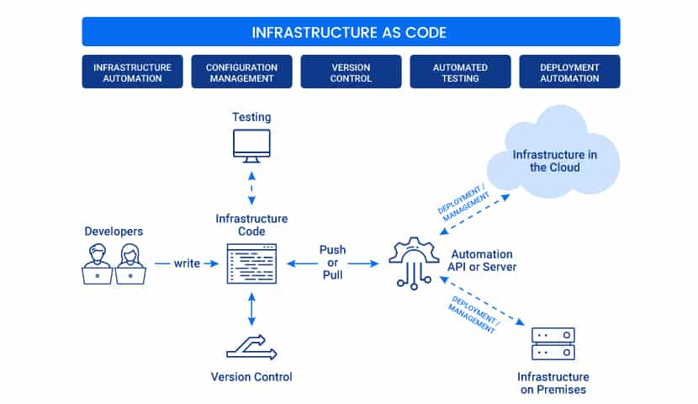
Notes:
Saad to share final Grafana dashboard

Slide 8
IaC Tools
Azure Resource Manager (Azure)
CloudFormation (AWS)
Deployment manager (GCP)
Terraform
Notes:
Saad to share final Grafana dashboard

Slide 9


Key Concept
Imperative what to do
Declarative
what is desired
Forward 1 mile
Turn right
Forward 2 miles
Turn left
Forward 3 miles
Arrive at pizza restaurant
Go to the pizza restaurant
Notes:
Saad to share final Grafana dashboard

Slide 10
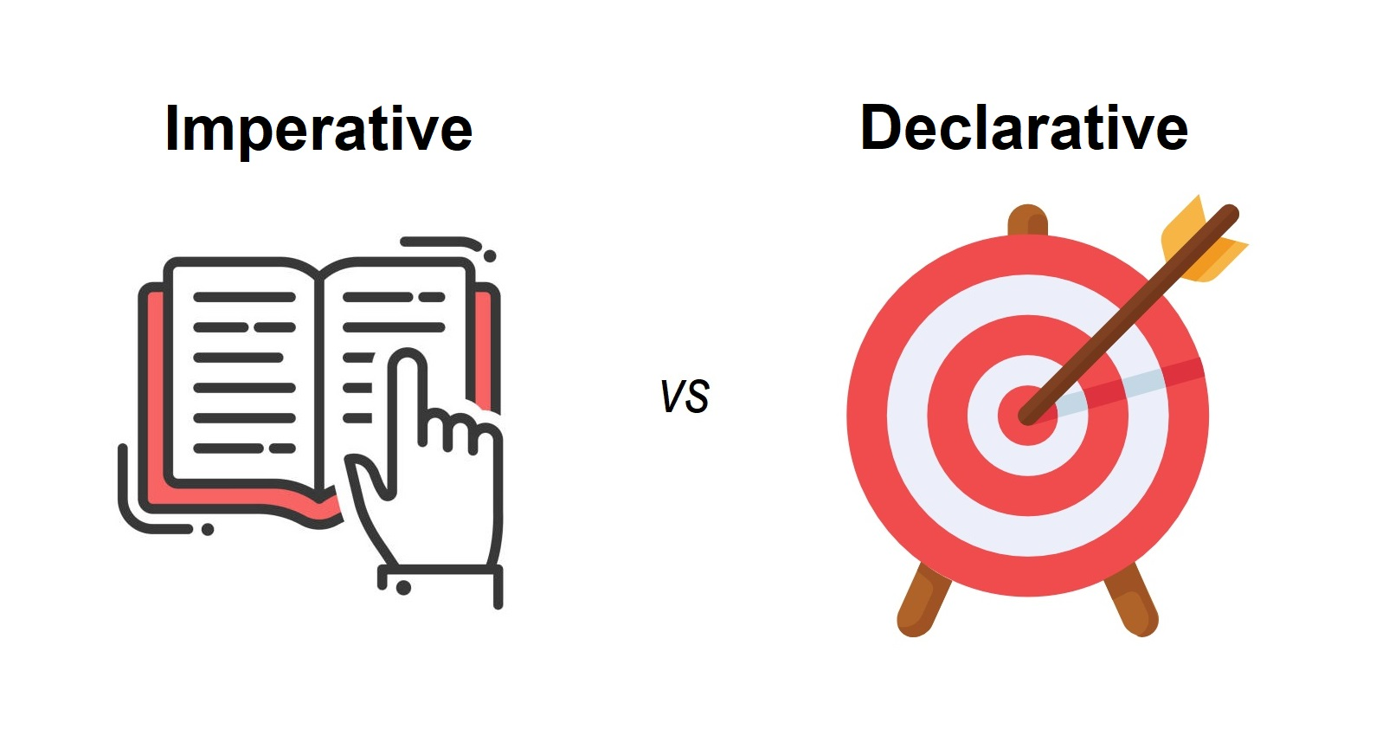
Imperative what to do
Declarative
what is desired
Starting point is crucial
Audit Complexity
Drift Detection Challenges
Lack of version control hinders the ability to track changes and revert to previous states
Replicating processes becomes problematic, leading to non-repeatable outcomes
Replicating processes becomes problematic, leading to non-repeatable outcomes
Changes to destination requires significant modifications
Starting point does not matter
Engine determines how to get to destination
Idempotent property
Repeatable in a pipeline
Easy to validate and detect drift
Can be version controlled
Changes to destination automatically handled
Notes:
Saad to share final Grafana dashboard

Slide 11





Benefits
Version Control & Collaboration
Speed & Efficiency
Cost Savings
Consistency and Reliability
Security and Compliance
IaC enables efficient resource allocation, ensuring that resources are provisioned only as needed. This leads to reduced over-provisioning and lower cloud infrastructure costs
IaC configurations are treated as code and can be stored in version control systems (e.g., Git). This enables collaboration among teams and tracks changes over time.
Provisioning resources manually can take hours or days. IaC drastically reduces this time to minutes, accelerating the deployment of applications and services
IaC enforces consistent infrastructure configurations across different environments, reducing discrepancies between different environments
IaC allows organizations to define security settings and compliance policies as code. This ensures that all resources are provisioned with the necessary security measures.
Notes:
Saad to share final Grafana dashboard

Slide 12
IaC with Terraform
Terraform is one of the most popular Infrastructure-as-code (IaC) tool, used by DevOps teams to automate infrastructure tasks. It is used to automate the provisioning of your cloud resources. Terraform is an open-source, cloud-agnostic provisioning tool developed by HashiCorp and written in GO language.

Slide 13



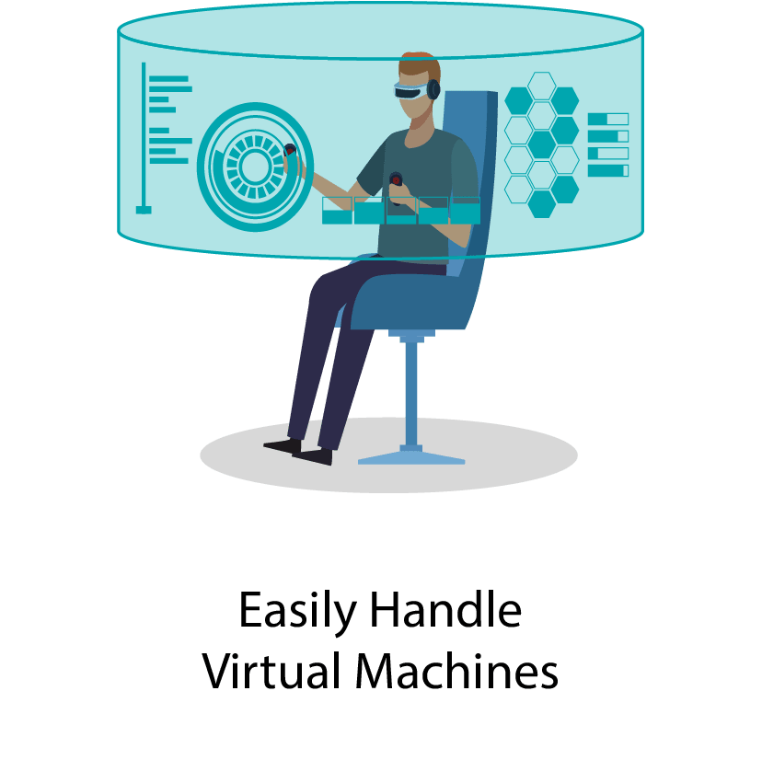

Terraform Features
Infrastructure as Code (IaC)
1
Terraform embraces the IaC methodology, allowing you to define infrastructure configurations using code.
1
Declarative Syntax
2
Terraform uses a declarative language to define the desired state of your infrastructure.
State Management
3
Terraform maintains a state file that records the current state of your infrastructure.
Parallelism and Efficiency
4
Terraform can provision and update resources in parallel, improving performance and reducing the time needed for large-scale deployments
Notes:
Saad to share final Grafana dashboard

Slide 14
Terraform Workflow
Init
Validate
Plan
Apply
Destroy
Use to initialize a working directory containing a terraform config files
Validates the terraform config files to ensure that they are syntactically valid and internally consistent
Creates an execution plan
Terraform performs a refresh and determines what actions are required to archive the desired state specified in config files
Use to apply changes required to reach the desired state of the configuration
By default, apply scans the current directory for the config and apply the changes
Use to destroy the terraform managed infrastructure
Notes:
Saad to share final Grafana dashboard

Slide 15
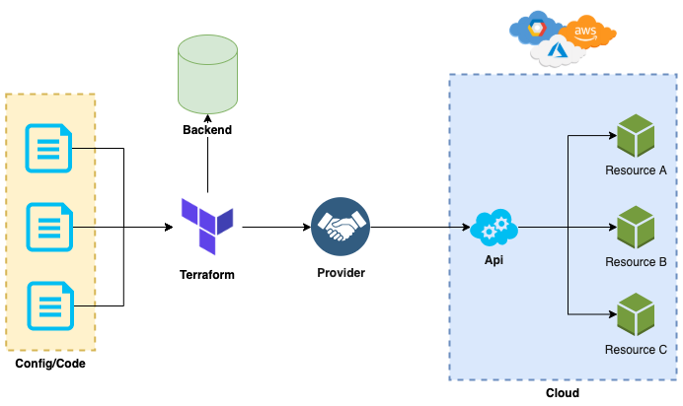
How terraform works?
Holds information about the current infrastructure in a state file on the configured backend.
Translates terraform configurations
into API calls to the respective
platform’s services
Configuration files are a set of files used to describe infrastructure in Terraform and have the file extensions .tf and .tf.json.
Notes:
Saad to share final Grafana dashboard

Slide 16
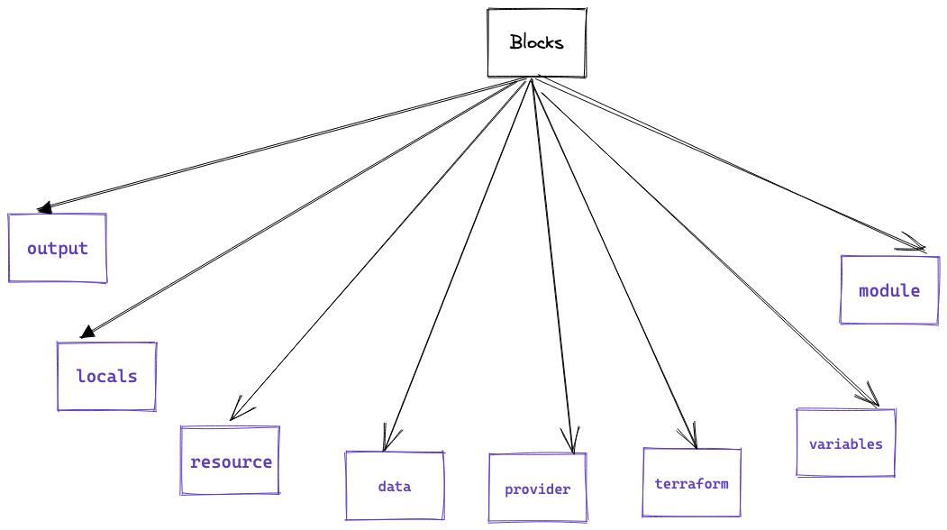
Different Types of Blocks in Terraform
In Terraform, a block is a fundamental unit used to define and configure different aspects of your infrastructure. Blocks are written in HashiCorp Configuration Language (HCL) and allow you to declare resources, providers, variables, outputs, and other configuration elements within your Terraform code. Each block serves a specific purpose and has its own syntax and set of properties.
Notes:
Saad to share final Grafana dashboard

Slide 17
Hands-On Lab: Terraform Basics

Slide 18
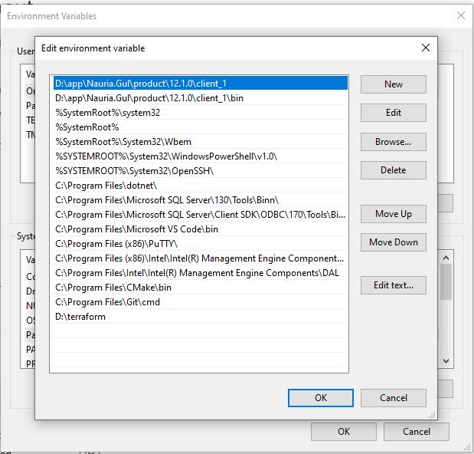
Installing Terraform on Windows
1. Download the package from the link shared below:
https://releases.hashicorp.com/terraform/1.6.5/terraform_1.6.5_windows_386.zip
2. Unzip the archive and rename it to terraform.
3. Add terraform path in Path variable as shown in below screenshot

Slide 19
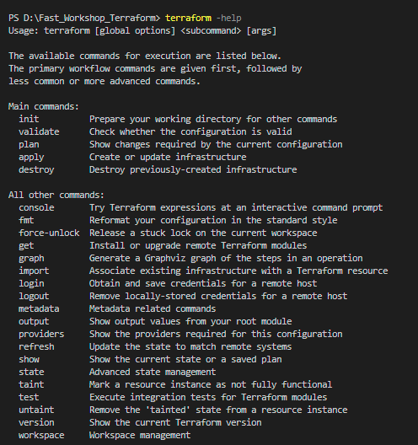
Verify the installation
Verify that the installation worked by opening a new powershell or cmd session and listing Terraform's available subcommands.
terraform -help

Slide 20
Lab 1:
In this lab, you will create a Terraform configuration to deploy an Azure resource group. This resource group is the foundation for the infrastructure you will build in the subsequent exercises.
Prerequisites
An Azure subscription.
Terraform 0.14.9 or later
The Azure CLI Tool installed
Install the Azure CLI tool
Invoke-WebRequest -Uri https://aka.ms/installazurecliwindows -OutFile .\AzureCLI.msi; Start-Process msiexec.exe -Wait -ArgumentList '/I AzureCLI.msi /quiet'; rm .\AzureCLI.msi

Slide 21
Authenticate using the Azure CLI
Login to az with your account credentials
az login --user devops1@tpsonline.com --password xxxxxxxxxxx
2. Choose the account subscription id and set the account with Azure CLI:
az account set --subscription "e15543c7-670b-435c-subscription-id“
Create a Service Principal
A Service Principal is an application within Azure Active Directory with the authentication tokens Terraform needs to perform actions on your behalf. Update the <SUBSCRIPTION_ID> with the subscription ID you specified in the previous step.
az ad sp create-for-rbac --name terraformrolelab --role Contributor --scopes /subscriptions/e15543c7-670b-435c-subscription-id
{
"appId": "e15543c7-670b-435c-95aa-a971848db8be",
"displayName": " terraformrolelab",
"password": “xxxxxxxxxxxxp0VwPkkeo1PCGfyEfqEhWo4aRJ",
"tenant": “xxxxxx-xxxx-470f-8fd0-f120bc75a518"
}

Slide 22
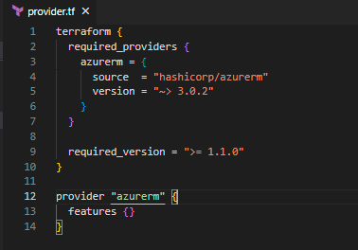
Set your environment variables
$Env:ARM_CLIENT_ID = "<APPID_VALUE>“
$Env:ARM_CLIENT_SECRET = "<PASSWORD_VALUE>“
$Env:ARM_SUBSCRIPTION_ID = "<SUBSCRIPTION_ID>"
$Env:ARM_TENANT_ID = "<TENANT_VALUE>“
Write configuration
1. Create a provider.tf file in you folder and paste the following code:

Slide 23
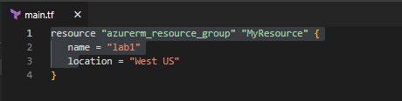
2. Create a main.tf file in you folder and paste the following code:
3. Run terraform init to initialize your working directory.
4. Run terraform validate to make sure your configuration is syntactically valid and internally consistent.
5. Run terraform apply to apply your configuration.

Slide 24
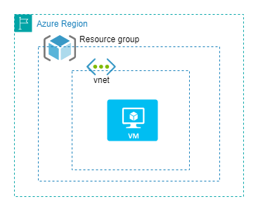
Lab 2:
In this lab, you will create a Terraform configuration to deploy an Azure resource group, Virtual network and a VM on Azure cloud.

Slide 25
Task:
Assign a public IP to the vm created in lab 2 with terraform code.

Slide 26

Thank you!
*All logos belong to their respective owners

